Slide 1
Protocol Basics

Slide 2
Protocol Basics
A protocol is a command set which can be interpreted at least by 2 partners.
Example:
  The human voice is the transport channel -> physical layer
  The protocol is the language -> protocol layer
To get communication established, both partners have to speak the language to get data transferred between these partners
  Example:
    I do my presentation in English as I assume most of the attendees speak and understand English
      Communication can be established
    If I would do the presentation in Japanese, I am quite sure that nobody would understand what I am talking about.
      No communication can be established
        As I am not speaking any japanese at all
        You don‘t understand this language

Slide 3
Protocol Basics
To get data transferred from one point to the other the physical layer needs to be ok and tested
  Example:
    If I would have problems with my voice and weren‘t able to speak you wouldn‘t hear anything
    Even if you were able to interpret my used protocol ( language ), there would be no communication
Normally the test of the physical layer is done using an oscilloscope
  Jitter Test
  Rise Time
  Eye Diagram

Slide 4
Protocol Basics
Assuming the physical layer is correctly working, the protocol layer needs to be checked.
As mentioned before, the protocol is a kind of command set which can be interpreted by the sender and the receiver
  Depending on the protocol the sender has different names
    Host -> USB
    Master -> General
    Root Complex -> PCIe
  The Receiver is known as
    Device -> USB, PCIe
    Slave -> Bluetooth

Slide 5
Protocol Basics
A protocol needs to be defined
  Like the languages used in real life, the protocol for instrumentation is standarized
    If someone would assume that the english language is based on the german wording, the protocol ( communication ) would never be successful.
This standardization is done by special interest groups ( Sig )
  Bluetooth -> Bluetooth Sig
  USB -> USB.org
  PCIe -> PCISig
This interest groups define the specification
  Bluetooth 5
  USB 3.1 GEN2 ( USB SuperSpeed+)
  PCIe GEN4 ( 16 Gbit x 16 Lanes )

Slide 6
Protocol Stack

Slide 7
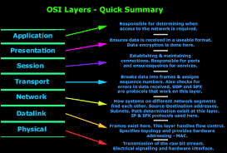
OSI Layers
Most of the protocols follow the OSI Layer model

Slide 8
A Layered Protocol Stack
Transfer
Transfer
Transaction
Transaction
Stack
Packet
Packet
Raw Data Stream
Notes:
Okay so now we know what a packet is lets go up a level and discuss transfers and introduce the concept of a stack
For one device to talk to another the data is formatted by the layers of the protocol stack
We know at the physical level this is a bit stream on a wire, data is formatted into packets
If I want to establish a transfer from device A to device B I will need to complete a number of transactions – e.g. define channel/buffer size, set transfer type, transfer information blocks, confirm the transaction complete, close the channel
Of course the end user experience is shown by the dotted lines where a virtual connection is established over the physical link to provide notional connectivity between protocol stack layers
Software people use the top levels

Slide 9
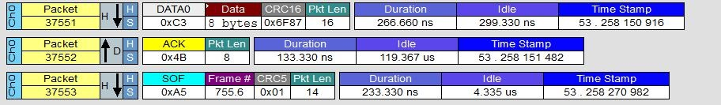
Packets
Packets showing the basic information
  Each Packet has a sequal number
  Each Packet contains the basic information
    Address
    Direction
      From Host to Device ( downstream )
      From Device to Host ( upstream)
    Checksum as error indication
    Payload
    Timing information
      Time stamp
      Transfer time

Slide 10
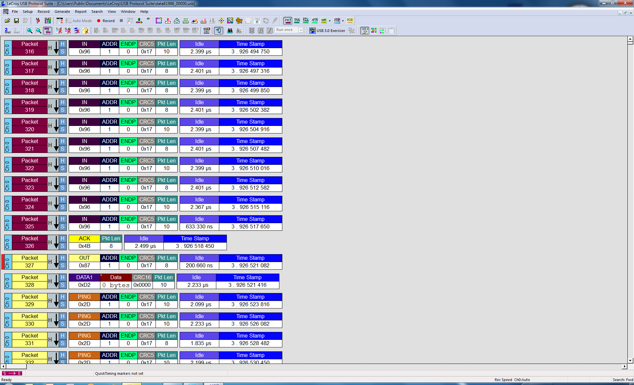
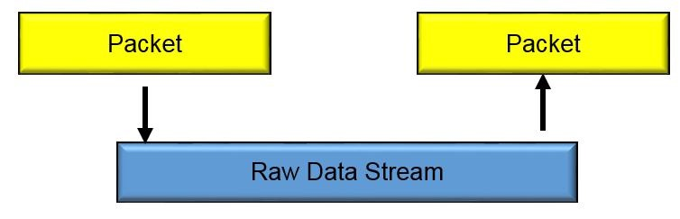
Packet Layer ( USB 2.0 )
Pre-Trigger Packet
Post Trigger Packet

Slide 11
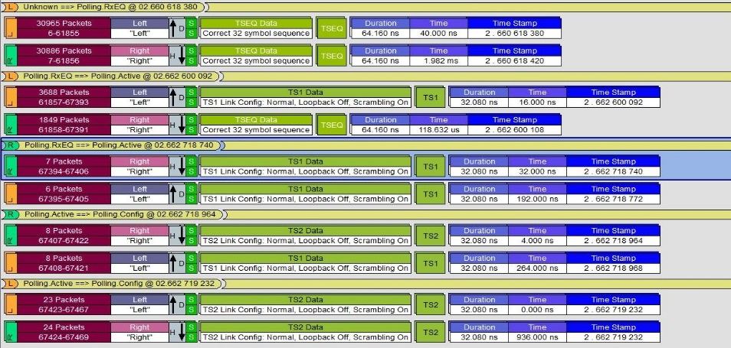
Data Link Layer
The Data Link Layer is responsible to get a stable communication established
  Speed
  Number of Lanes ( PCIe)
  Synchonization between Host / Device
Not all protocols do use the Data Link Layer
  USB 2.0
  Low Speed Protocols

Slide 12
Transaction & Transfer Layer
Transaction Layer:
What is shown in the transaction layer type is dependent of the protocol
  Group of logical packets in general
  Each Transaction Layer packet group has its own sequential number
Transfer Layer
  Group of logical packets connects transaction packets
  Each Transfer Layer packet group has its own sequential number

Slide 13
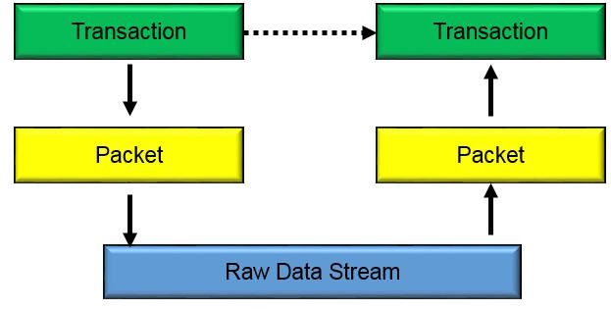
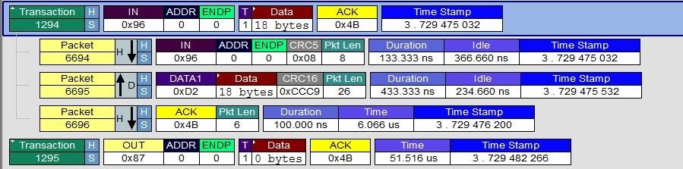
Transaction Layer (USB 2.0)

Slide 14
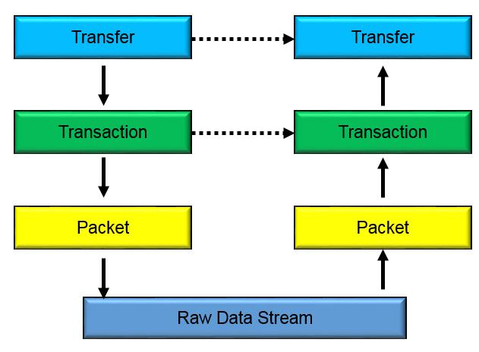
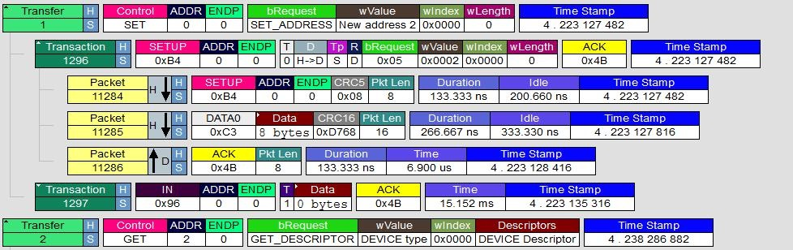
Transfer Layer (USB 2.0)

Slide 15


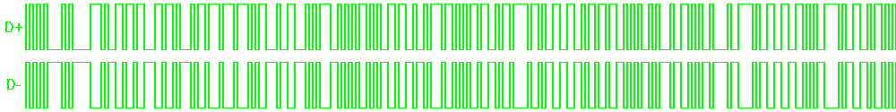
Viewing a Protocol Stack with a Protocol Analyzer
Transfer 180
Transfer 181
Link Transaction 362
Link Transaction 363
Packet 2563
Packet 2564
Packet 2565
Packet 2568
Bit Stream on differential wires
Notes:
So just to make sure you have understood what we just said, lets review
A bit stream is extracted to a packet
Packets are extracted into one or more transactions
Transactions may be transactions themselves of a higher level
Highest level transactions typically form a transfer

Slide 16
Protocol Layered Model
Application
Software
– Ethernet, NVMe, SOP, AHCI, SATA…
Transaction
Device Configuration and Control
Data Transfer to/from Memory
Data Link
Management of Packets:
Flow Control and ACK/NAK Protocol
Physical
Logical Sub Block
Link Training
Electrical Sub Block
Electrical (Analog) Signaling

Slide 17
Example PCI Express
Application
It is all inside the PCI Express Payload,
could include: NVMe commands,
Ethernet Frames etc.
Transaction
TLPs: Config Rd/Wr, Mem Rd/Wr,
IO Rd/Wr, Messages
Data Link
DLLPs: InitFC, UpdateFC, ACK, NAK
PM_Enter_L1 etc…..
Physical
Logical Sub Block
TS1, TS2 all Ordered Sets
Electrical Sub Block
Eye Diagrams, analog waveforms
Notes:
By protocol related this maps broadly onto the data link layer and transaction layers of the PCI Express specification and go down as far as link training in the physical layer.
Interestingly the most common problems are found in the data link layer possible because this has the least external visibility without a protocol analyser.

Slide 18
PCI Express Layer visibility
Software
Application
Ethernet, NVMe, SOP, AHCI, SATA…
Transaction
Device Configuration and Control
Data Transfer to/from Memory
Internal
Logic
Data Link
Management of Packets:
Flow Control and ACK/NAK Protocol
Physical
Logical Sub Block
Link Training
PHY
Electrical Sub Block
Electrical (Analog) Signaling
Notes:
By protocol related this maps broadly onto the data link layer and transaction layers of the PCI Express specification and go down as far as link training in the physical layer.
Interestingly the most common problems are found in the data link layer possible because this has the least external visibility without a protocol analyser.

Slide 19
How do two devices talk ? ( Example PCIe)
Root Complex
End Point
Application
Application
Transaction
Transaction
Data Link
Data Link
Physical
Physical
Logical Sub Block
Logical Sub Block
Electrical Sub Block
Electrical Sub Block
RX
TX
RX
TX

Slide 20
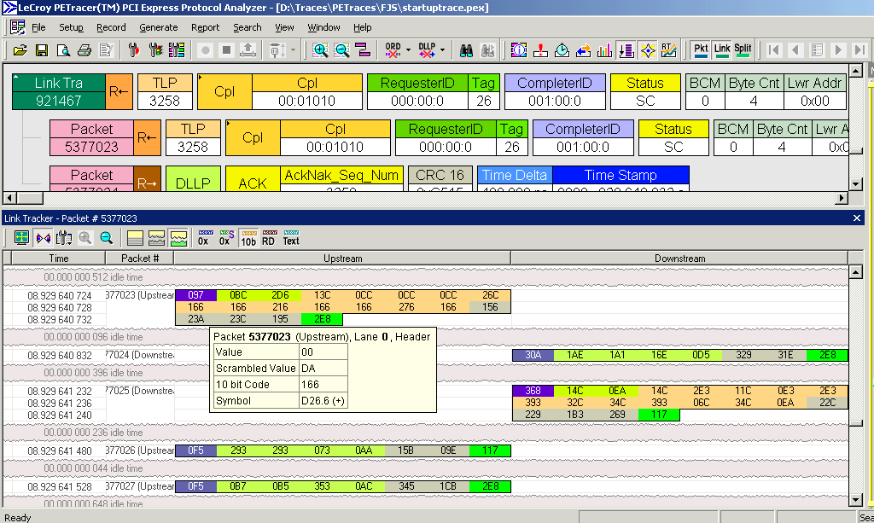
Where do Protocol-Analyzers capture the data ?
Point of Observation
Notes:
The problem of observing and following traffic with a non-dedicated instrument becomes even more complex when multiple asynchronous serial channels are aggregated to form a higher bandwidth link. Each additional link has its own independent scrambler and encoder which increases the complexity of tracking the link activity and displaying it in some useable way to the user.
Protocols like PCI-Express and Infiniband stripe the data across the links – each successive byte goes down a separate physical link, therefore the user or analyser must correlate and recombine the links to view useful information. If only one link was observed then no meaningful information could be recovered

Slide 21
Protocol Analyzer
Looking on the data transmission line
  Host <-> Endpoint / Device ( USB )
  Root Complex <-> Device ( PCIE )
Protocol analyzer sniffer on the bus-what is going on?
Checking the captured data related to the specification
Software Suites basically showing the spec’s
  No errors in the capture trace shown, compliant to the standard?
    Yes, in respect of the syntax of the protocol
    No, in respect of the complete specification
      No test of command has been execute in respect of timing
Protocol analyzer should not influence the transmission line
  Sometime it happens that problems disappear when adding a protocol analyzer
    Mainly problems related to the physical layer

Slide 22
Protocol Analyzer
Beside checking the captured trace in respect to the syntax they can help in solving the following problems
  Timing of packets
    Command / packet collisions
  Commands send in the right order
  Programming issues
    Wrong register setting
    Command send to the wrong endpoint / Device
  How long does it takes until a device responses to a request or vs.
    Completion Timing

Slide 23
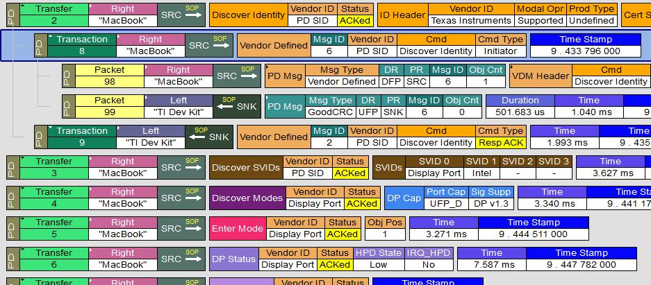
Protocol Analyzer
Advantages
  Showing each packet
  Longer capture window
    More memory
  Showing the protocol hierarchy
    Packets
    Transaction
    Transfer
  Performance Analysis
    Complex statistic
    Implementation of the protocol
  Triggering is done on the protocol stack
Disadvantages
  One protocol analyzer is needed per protocol
    No multiprotocol solution
  Needs some training time
    The protocol needs to be understood
  Physical layer needs to be working correctly
    Will show protocol errors but difficult to debug if they related to the physical layer

Slide 24
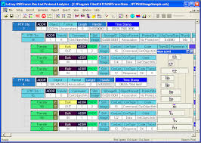
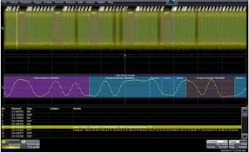
Which tool for which layer

Slide 25
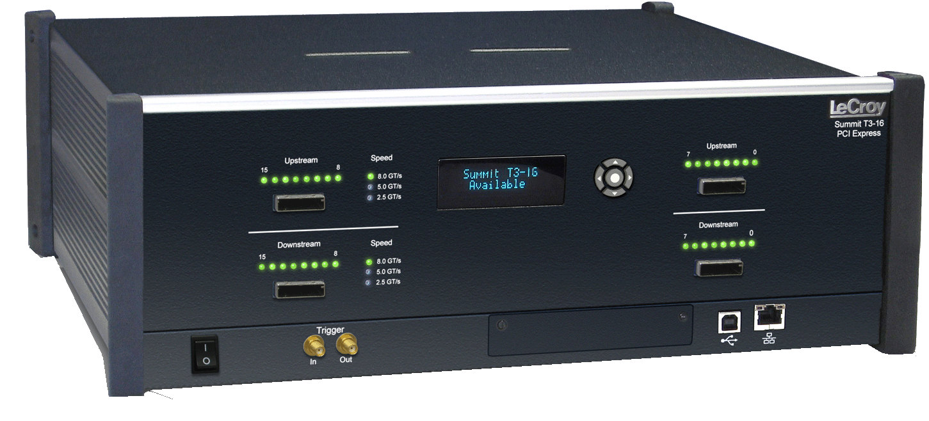
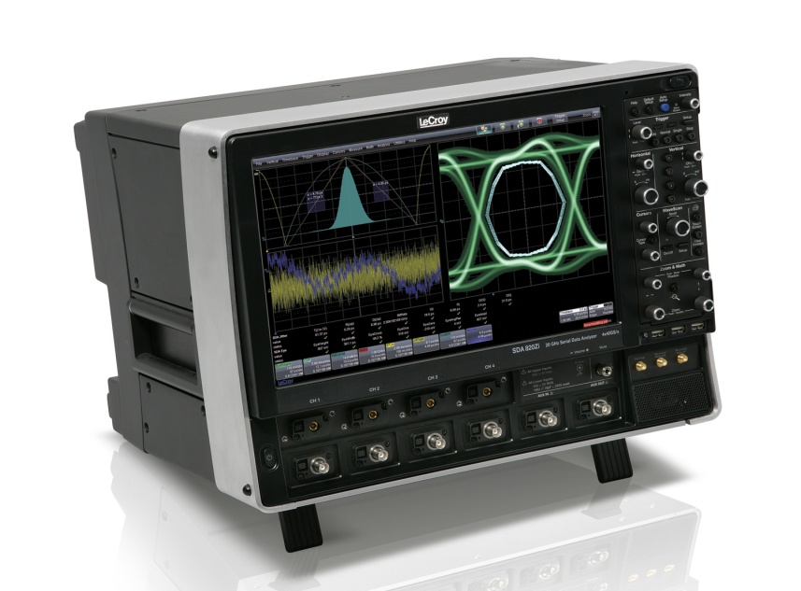
Hierarchy of High Speed Serial Data Standards
Software
Transaction
Logical Layer Test Tools Needed
Data Link
Physical
Physical Layer Test Tools Needed
Mechanical
Notes:
Protocol Analyzers are not the only tool needed to design, debug and validate communication systems, in-fact, If you are working on the mechanical layer or most of the physical layer, a protocol analyzer is the wrong tool and what you really need to do your job would be a good oscilloscope. But if you’re interested in or working anywhere from the top of the physical layer all the way through the software application itself, then a protocol analyzer is exactly the tool you need to effectively do your job.
To try to design, debug or validate in these area’s, without a protocol analyzer, would be like trying to build a house with your eyes closed. It can be done but not without delay’s and the end result would be questionable and you could guarantee that there would be many hidden flaws.

Slide 26
When to use which tool
Half Duplex Serial
Full Duplex Serial
Asynchronous Multi Lane Serial
Synchronous Parallel
(>4bits wide)
Application
(High level software command)
Interface
Encoding (Takes AI and codes it to Protocol
Physical
(Amp or diff driver) Interface
Oscilloscope
Logic Analyser
Protocol Analyser

Slide 27
If I had to choose a tool…
O’scope
Software
tools
PHY
Tools
Protocol
analyzer
Application
All inside the PCI Express Payload,
could include: NVMe commands,
Ethernet Frames etc.
☒
☒
☑
☑
Transaction
TLP’s: Config Rd/Wr, Mem Rd/Wr,
IO Rd/Wr, Messages
☒
☒
☑
☒
Data Link
DLLP’s: InitFC, UpdateFC, ACK, NAK
PM_Enter_L1 etc…..
?
☒
☑
☒
Physical
Logical Sub Block
Ordered Sets: TS1, TS2 , Skip
☑
?
☑
☒
Electrical Sub Block
Eye Diagrams, analog waveforms
Notes:
By protocol related this maps broadly onto the data link layer and transaction layers of the PCI Express specification and go down as far as link training in the physical layer.
Interestingly the most common problems are found in the data link layer possible because this has the least external visibility without a protocol analyser.

Slide 28
Where a protocol analyzer can solve a problem but a scope not
Application
Transaction layer problems mostly due to legacy carry over (at present)
Data link layer problems can be the most difficult to detect in development
Physical layer issues for protocol are mostly related to the LTSSM
Transaction
Data Link
Physical
Logical Sub Block
Electrical Sub Block
Notes:
By protocol related this maps broadly onto the data link layer and transaction layers of the PCI Express specification and go down as far as link training in the physical layer.
Interestingly the most common problems are found in the data link layer possible because this has the least external visibility without a protocol analyser.

